Slide 1
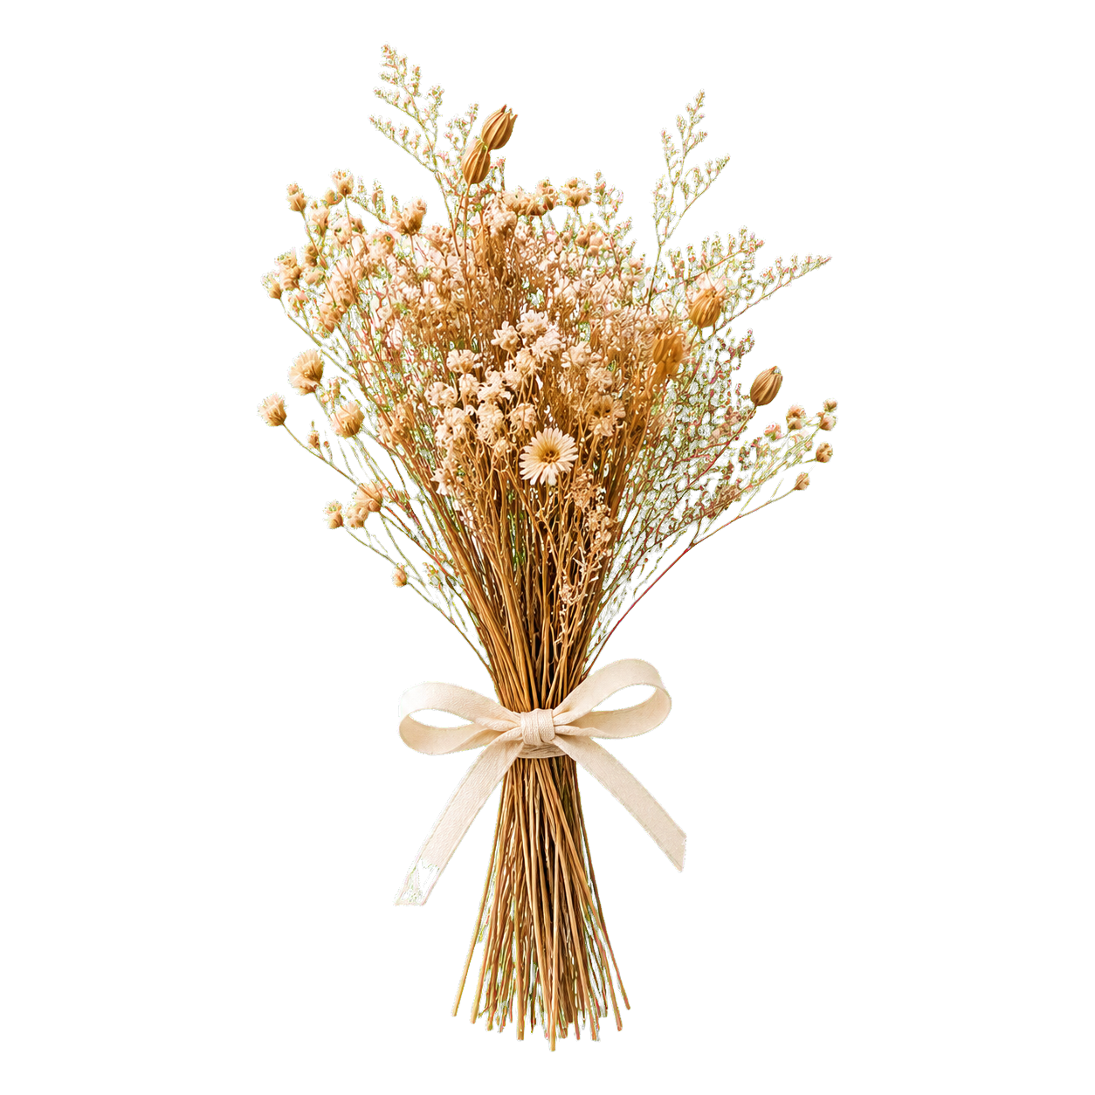
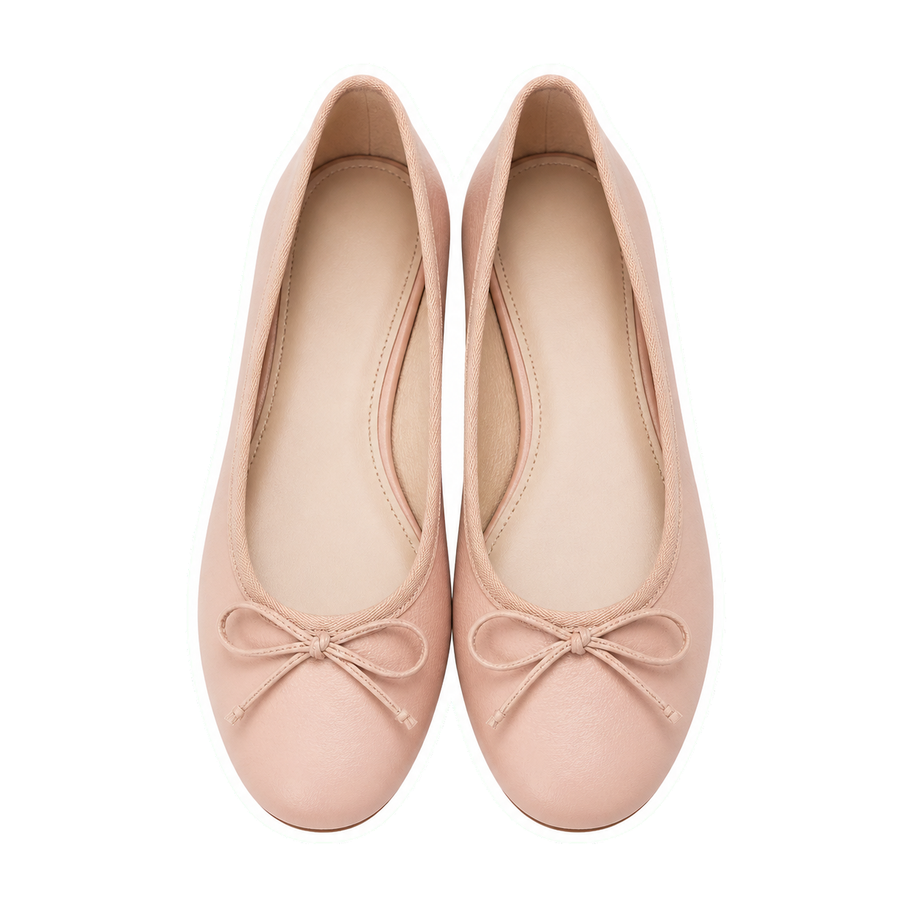








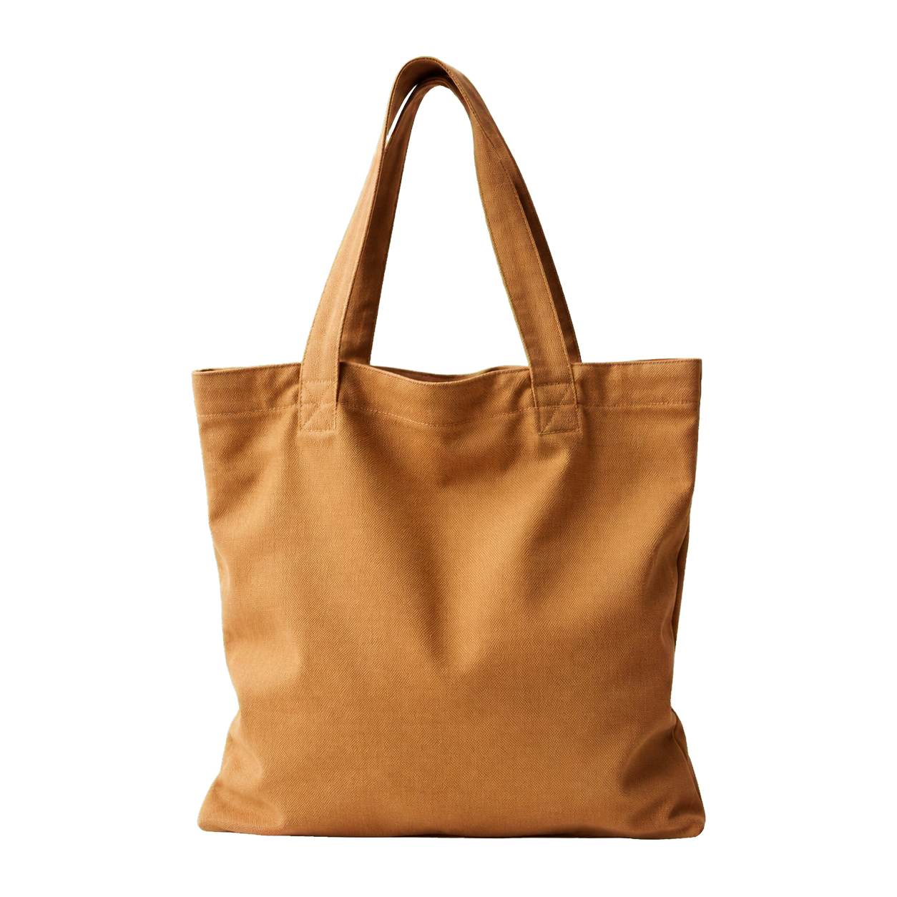

journal notes · vol. 01
3 journal
prompts
for when you
feel stuck
make
time
for
you
swipe for a softer way back to yourself
a slow morning, saved
01 / 04

Slide 2

journal notes · 01 / 03
start here
name it
what feels heavy because
i haven’t named it yet?
give the feeling
a name.
write the truest answer first.
you can make sense of it later.
01

Slide 3


journal notes · 02 / 03
then ask
loosen
the grip
where am i demanding certainty
before i let myself begin?
let the answer be unfinished.
that is still an answer.
one page at a time
02

Slide 4


journal notes · 03 / 03
come back to this
begin
small
what is one kind thing
i can do in the next ten minutes?
a little
counts.
make it small enough that
you can begin before you overthink it.
03

